Slide 1
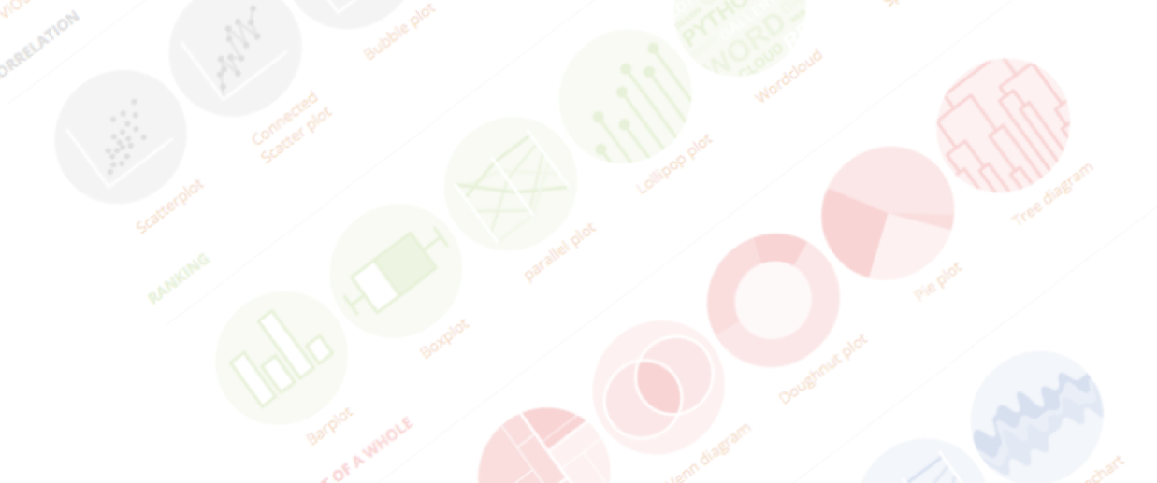

A project by Yan Holtz and Conor Healy
A classification of chart types based on input data format
Dataviz Meetup | Toulouse | June 2019

Slide 2

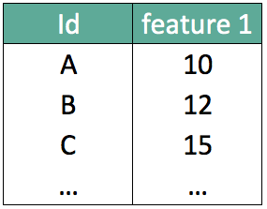
What should I do with my data ??

Slide 3
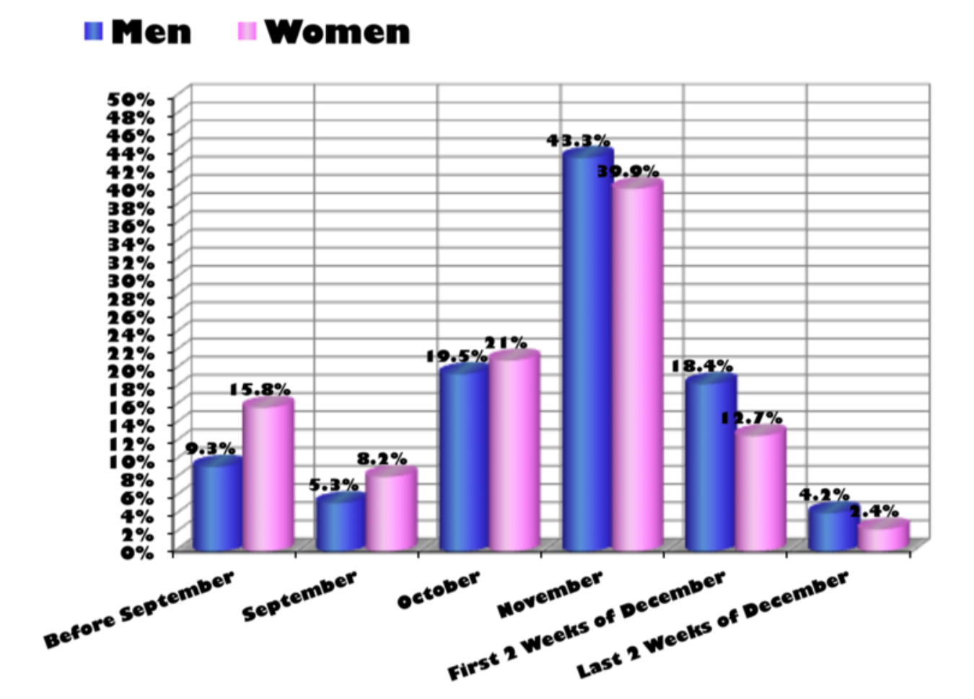
…
What about that?
Source: Storytelling with data by Cole Nussbaumer Knaflic

Slide 4
Looking for a chart ?
What you can do
What you should do
Caveats to avoid
How to
build it

Slide 5
WHAT YOU CAN DO
A classification of chart types based on data input format
www.data-to-viz.com/#explore

Slide 6
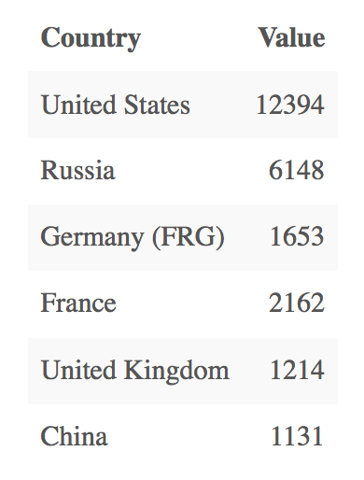
Who sells more weapons ?
?
Notes:
Very simple dataset,
-> What would you do ?
quantity of weapons exported by the top 50 largest exporters in 2017.
on the Stockholm International Peace Research Institute

Slide 7
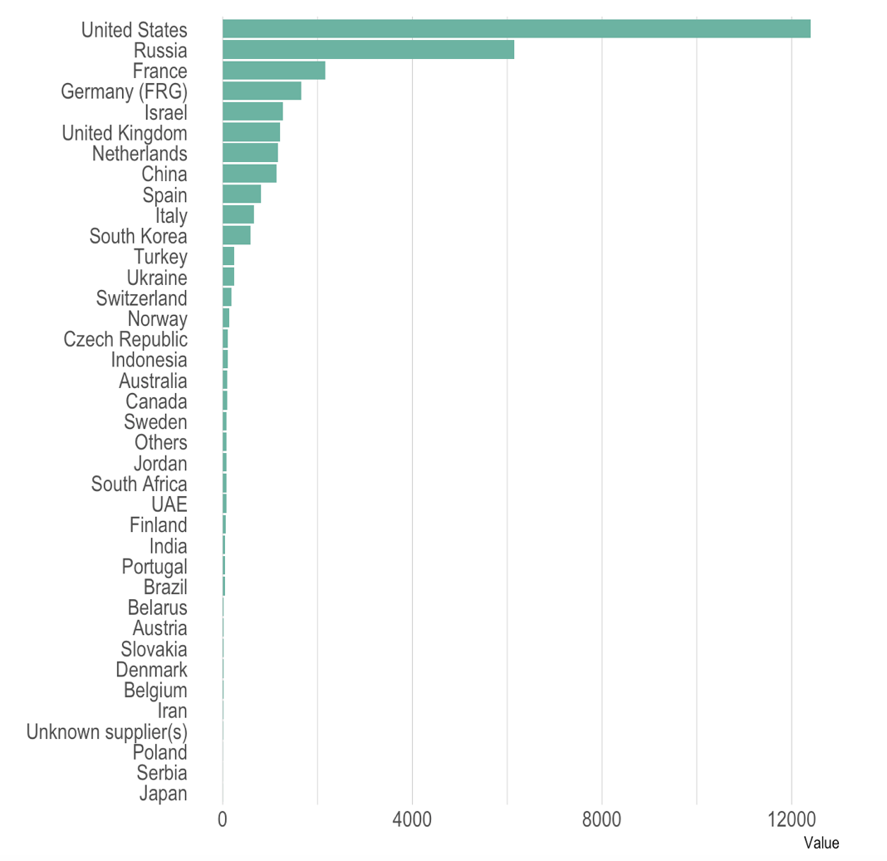
Who sells more weapons ?

Slide 8
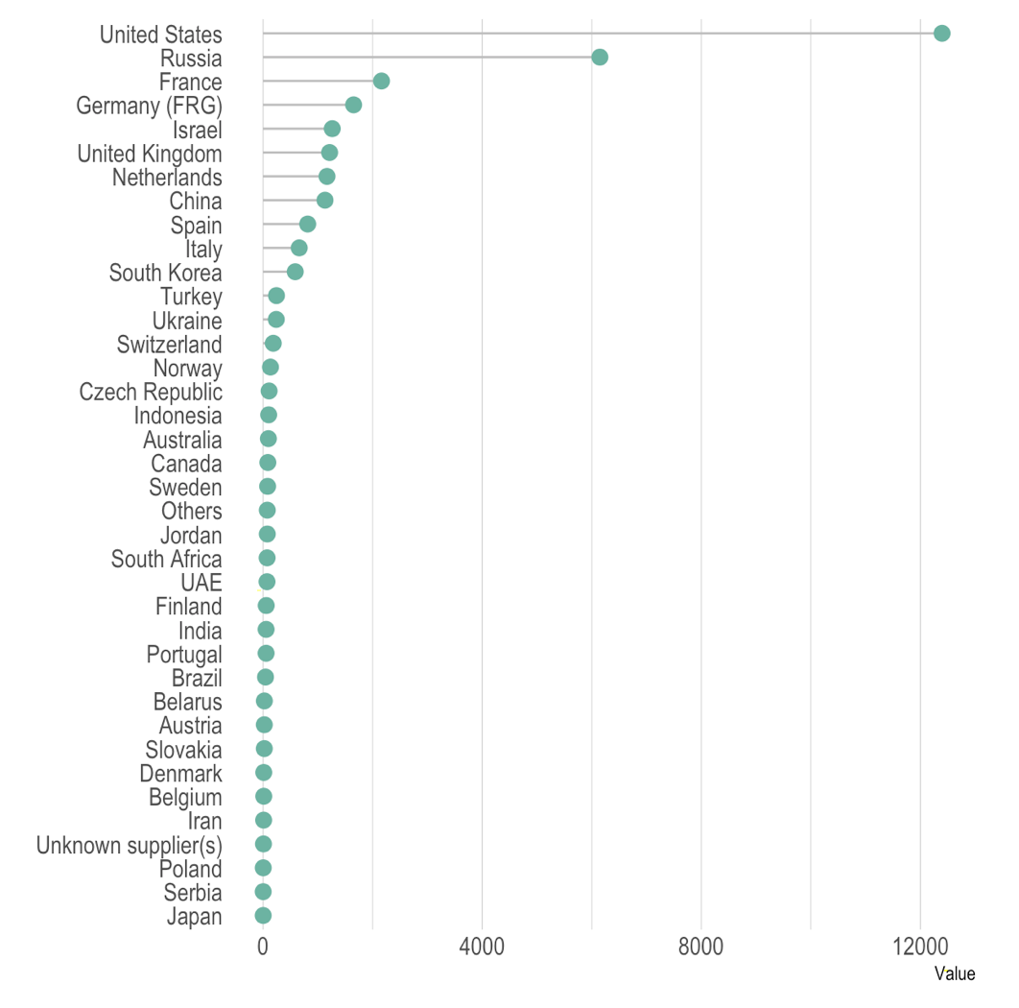
Who sells more weapons ?

Slide 9
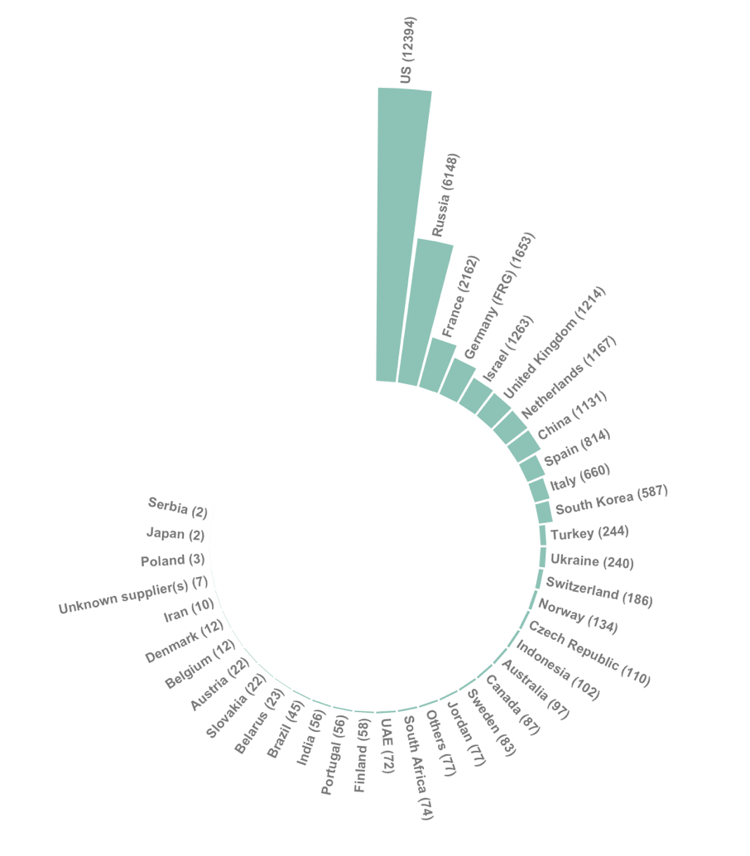
Who sells more weapons ?

Slide 10
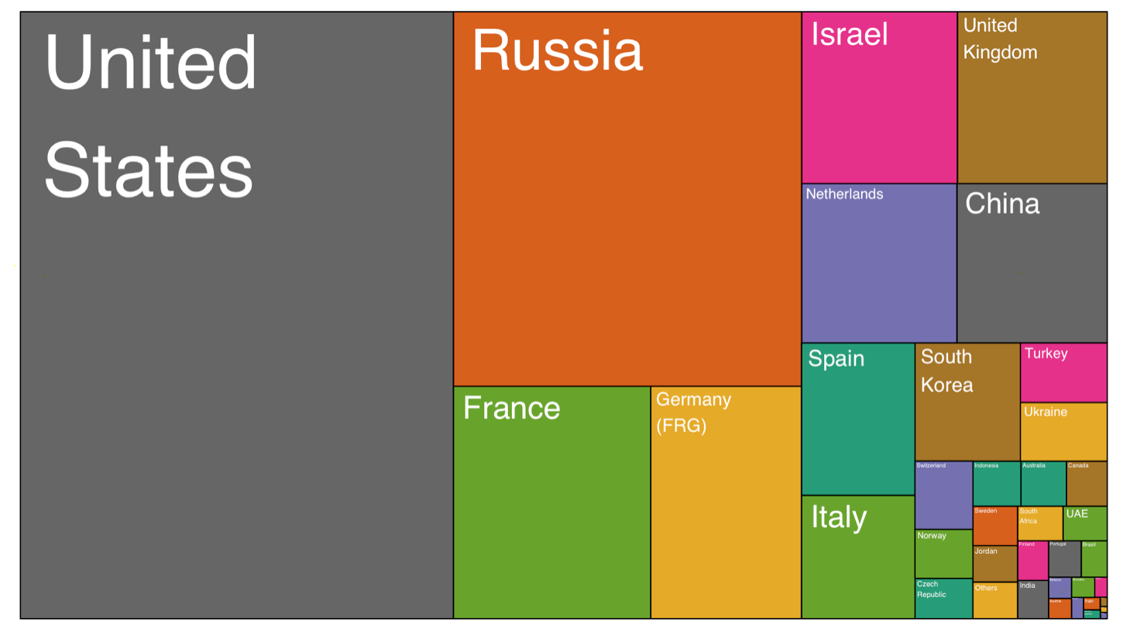
Who sells more weapons ?

Slide 11
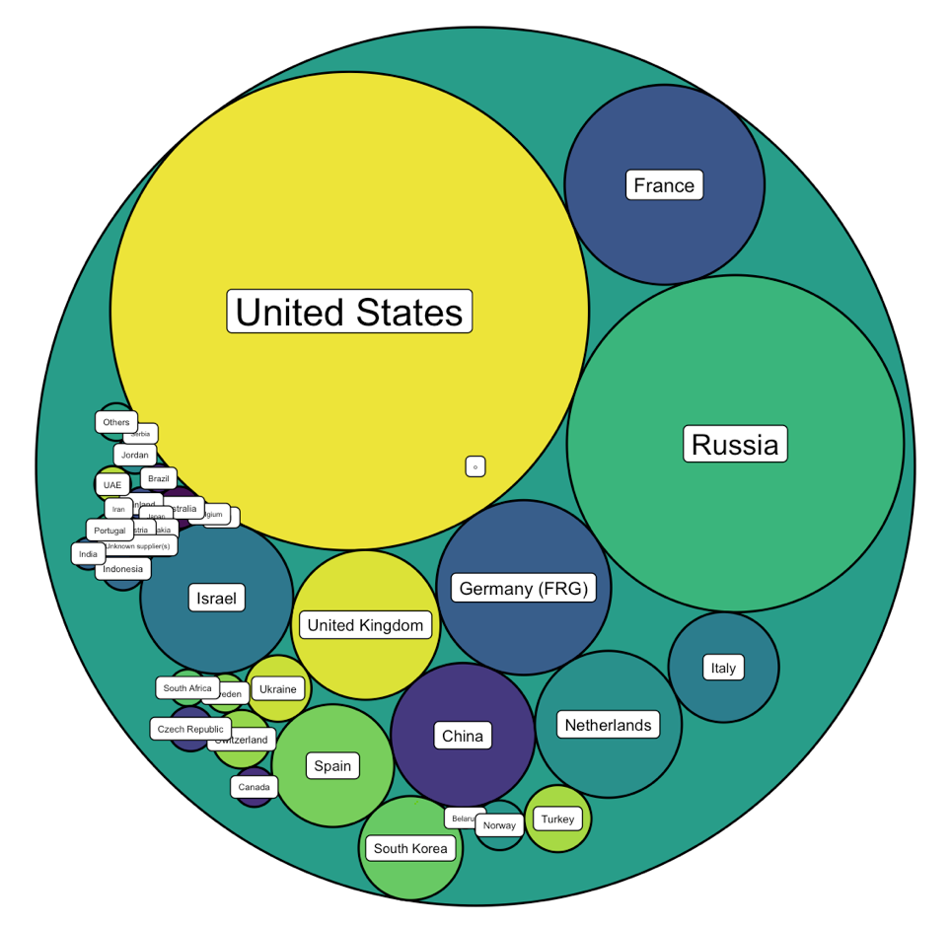
Who sells more weapons ?

Slide 12







Who sells more weapons ?

Slide 13
Who sells more weapons ?
1 observation per group
1 categorical variable
1 numerical variable

Slide 14
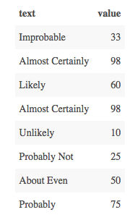
Perception of probability

Slide 15
Perception of probability
Several observations per group
1 categorical variable
1 numeric variable

Slide 16
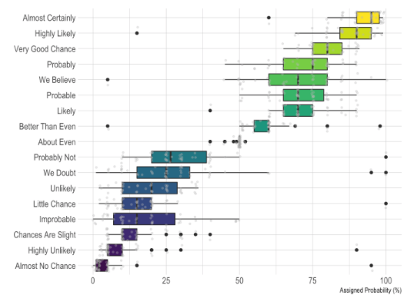
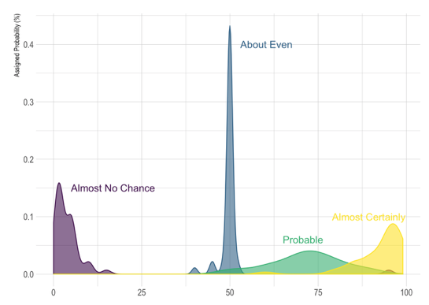
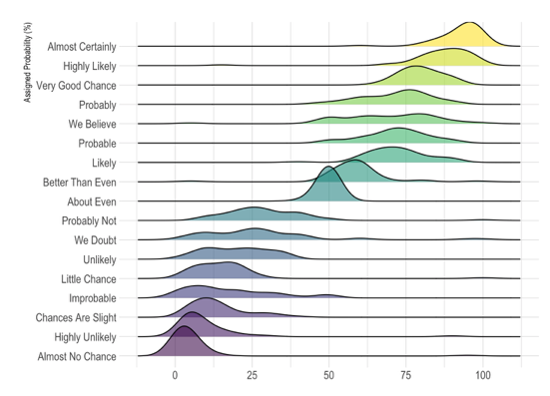
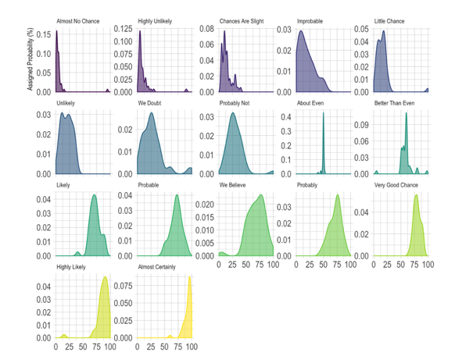
Perception of probability
Several observation per group
1 categorical variable
1 numeric variable

Slide 17
So…
Knowing the possibilities is the first step in chart choice
Not easy to know all the chart types
Hard to figure out options from a dataset
Let’s build a decision tree
Notes:
Demo first part of the website

Slide 18
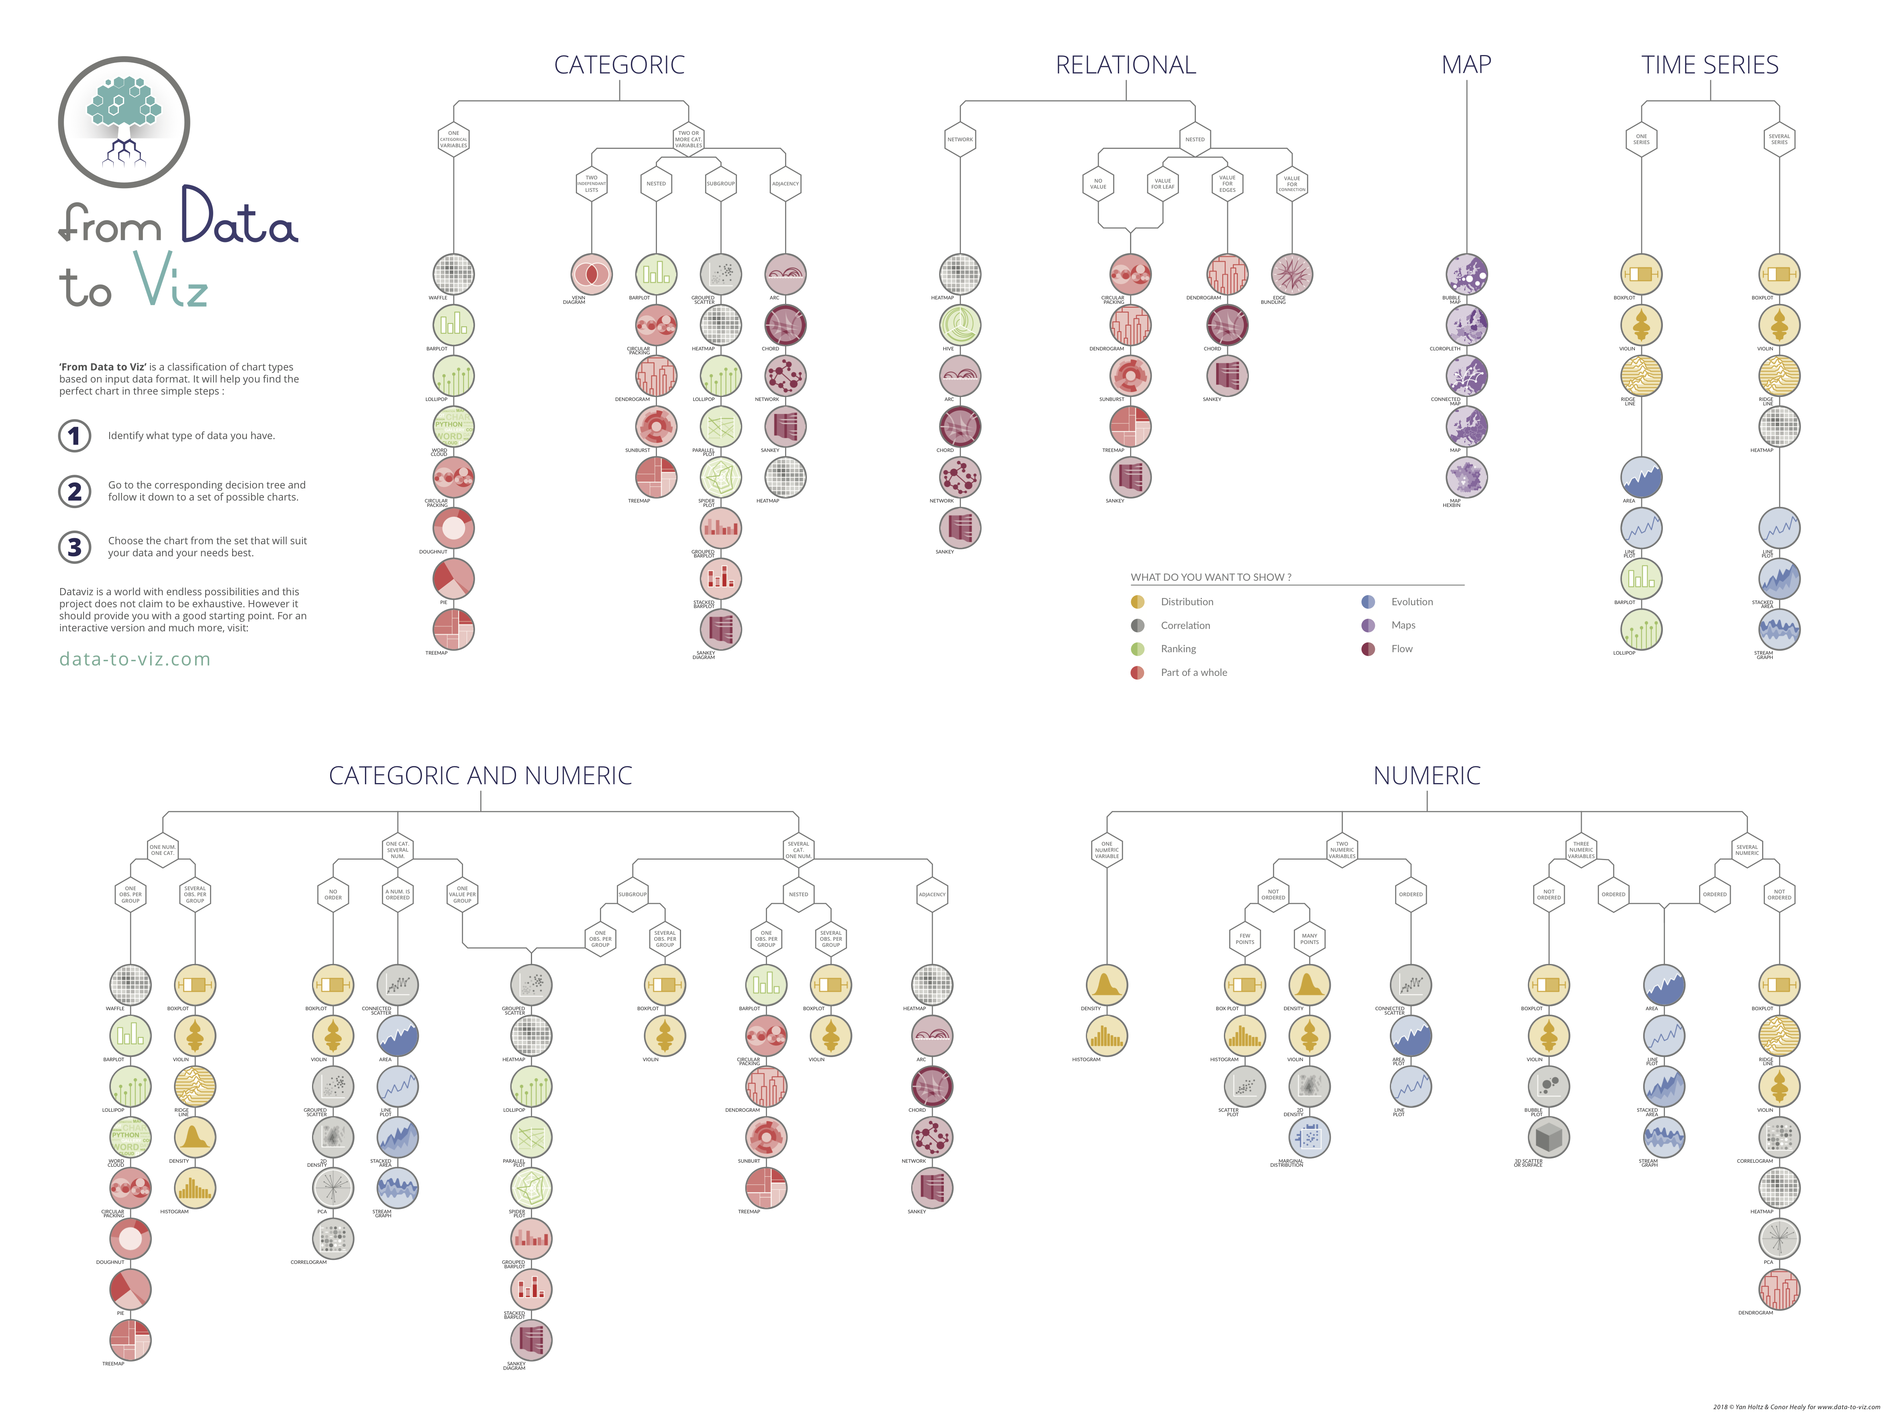
Notes:
+ WEBSITE DEMO

Slide 19
WHAT YOU SHOULD DO
About 20 examples of storytelling with data
www.data-to-viz.com/#story

Slide 20
Eye catching / accurate
Question
Exploratory vs Explanatory
Chart Decision
Interactive or Static?
Who’s reading ?
Data itself

Slide 21
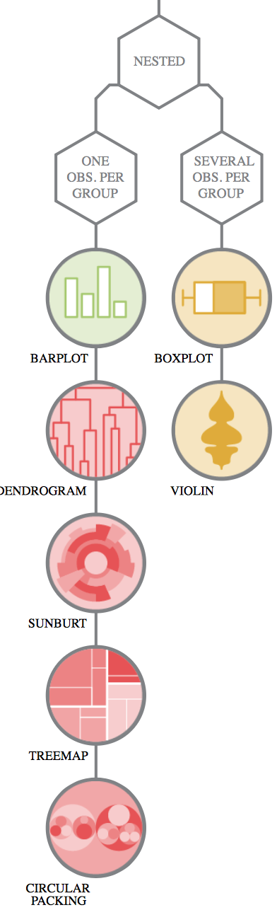
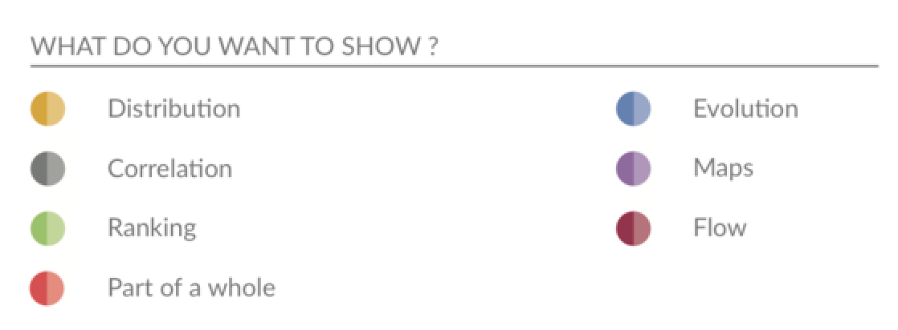
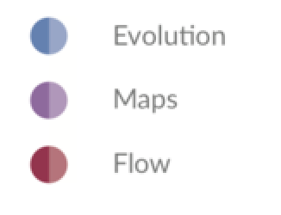
Question – Explo/Expla – Reader – Data – Interactivity – Eye catching
Notes:
Demo story part of the website Show that code is available

Slide 22
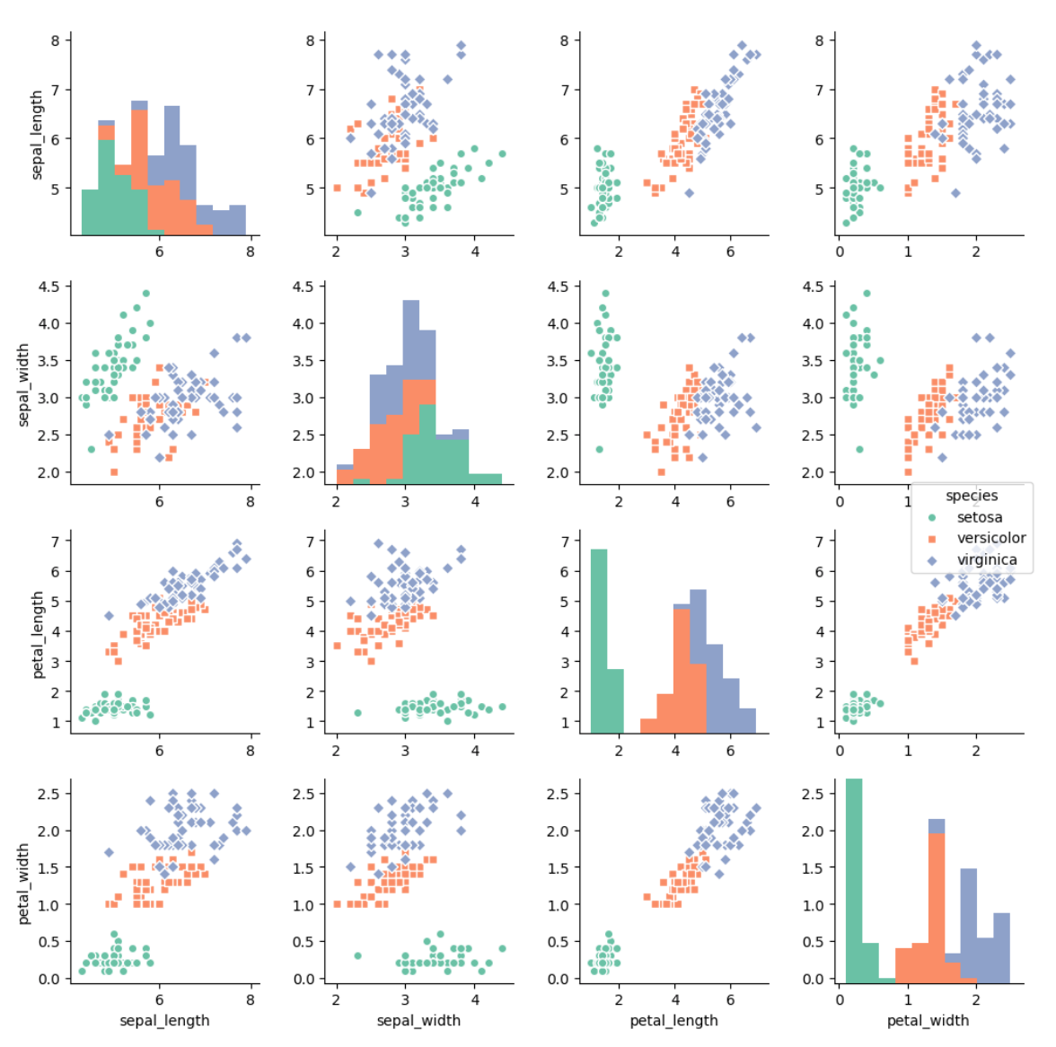
Question – Explo/Expla – Reader – Data – Interactivity – Eye catching
Notes:
Demo story part of the website Show that code is available

Slide 23
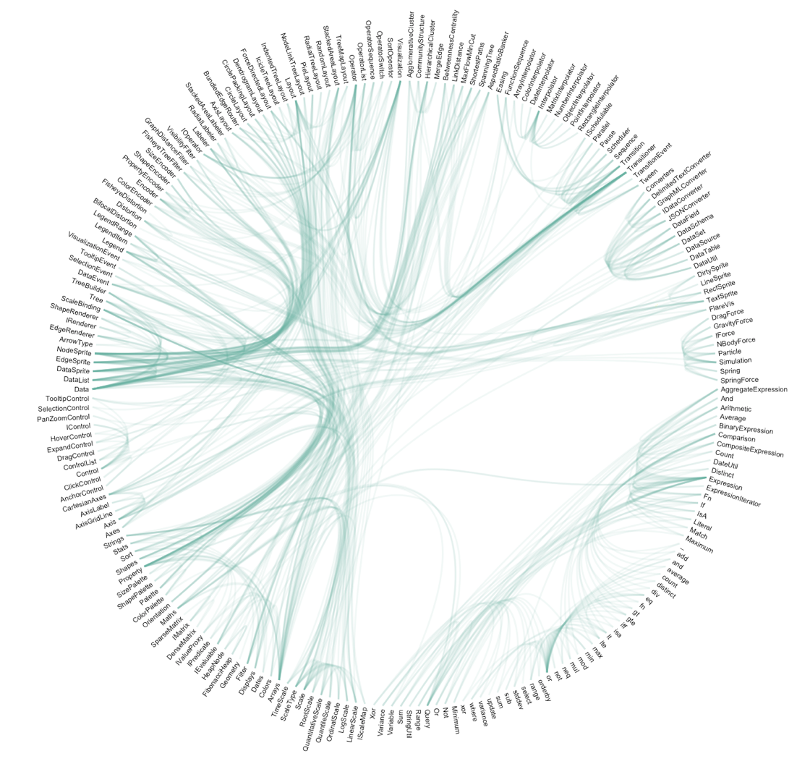
Question – Explo/Expla – Reader – Data – Interactivity – Eye catching
Notes:
Demo story part of the website Show that code is available

Slide 24
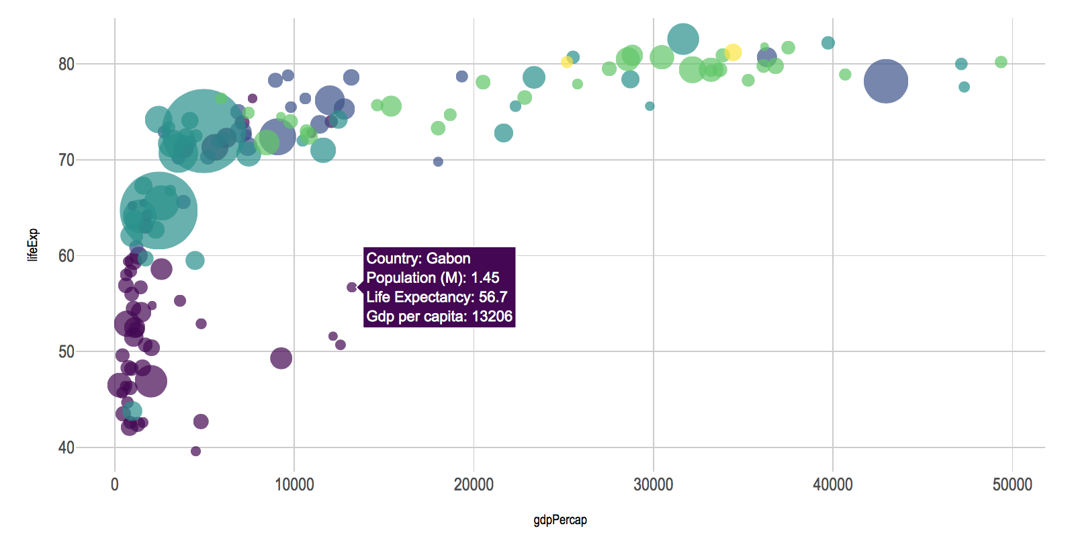
Question – Explo/Expla – Reader – Data – Interactivity – Eye catching
Notes:
Demo story part of the website Show that code is available

Slide 25
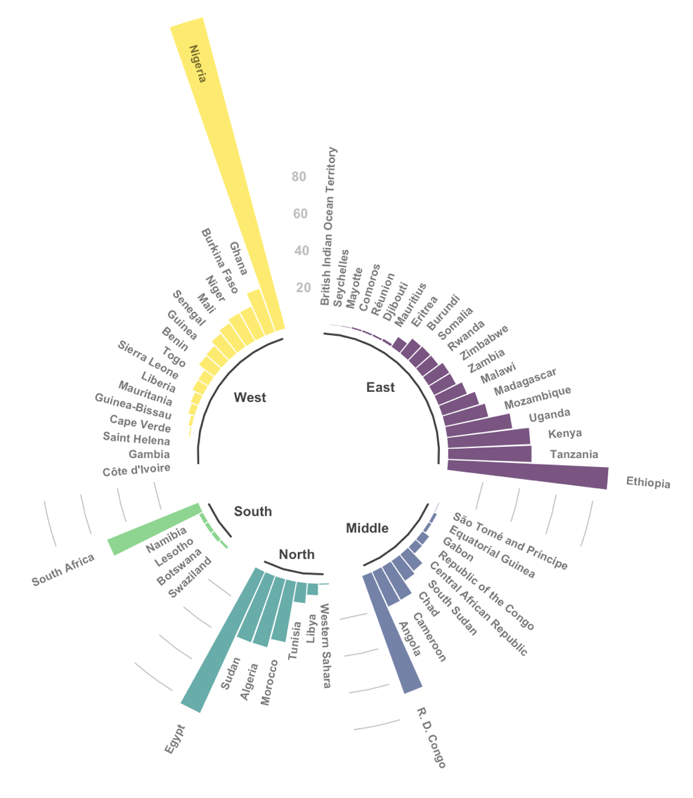
Question – Explo/Expla – Reader – Data – Interactivity – Eye catching
Notes:
Demo story part of the website Show that code is available

Slide 26
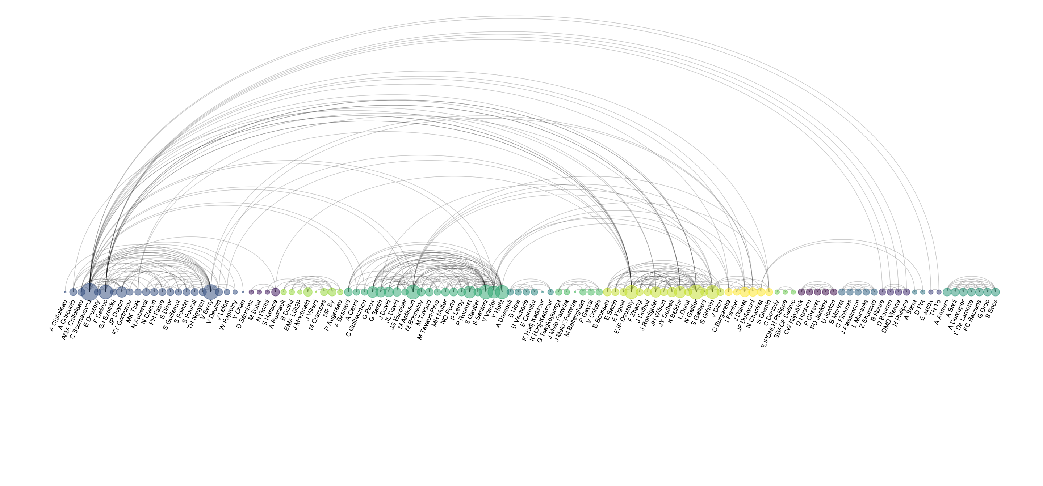
Co-authorship network of a researcher

Slide 27


Slide 28
WHAT YOU SHOULD NOT DO
A gallery of most common caveats
www.data-to-viz.com/caveats

Slide 29
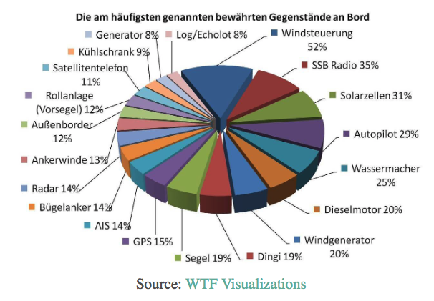
What’s wrong with this chart?

Slide 30
Calculation
+
3D
+
Pie chart

Slide 31
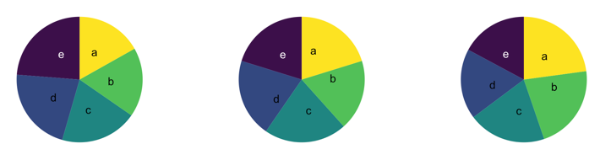
What’s wrong with pie chart?
What can you see?

Slide 32
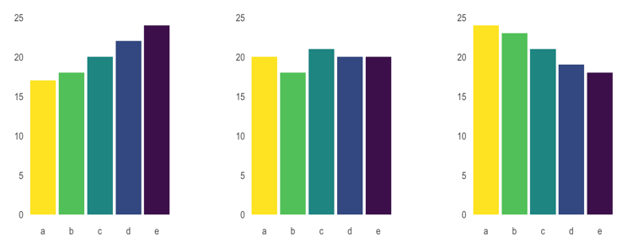
What’s wrong with pie chart?
It is hard to distinguish angles

Slide 33
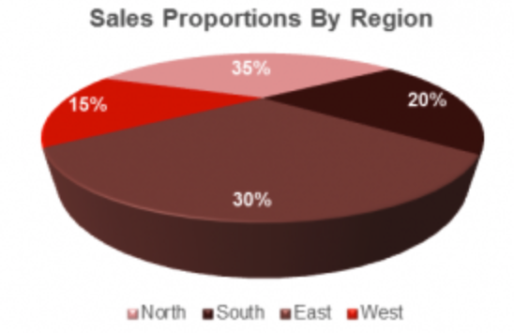
What’s wrong with 3D

Slide 34
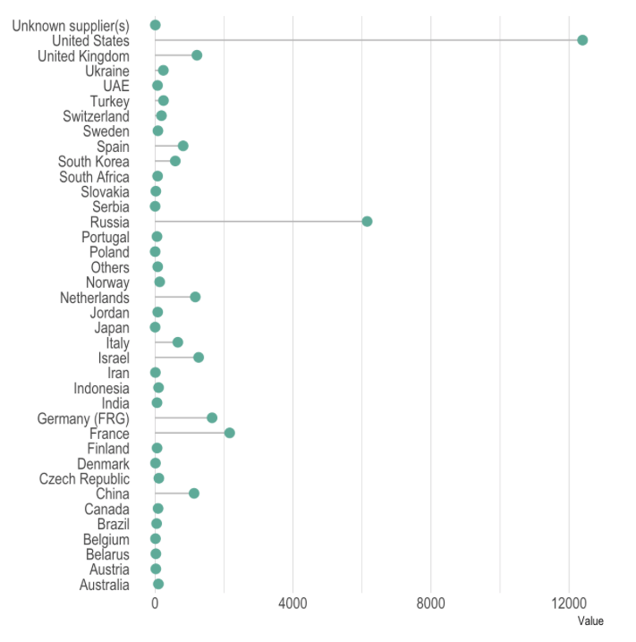
What could be better here?

Slide 35
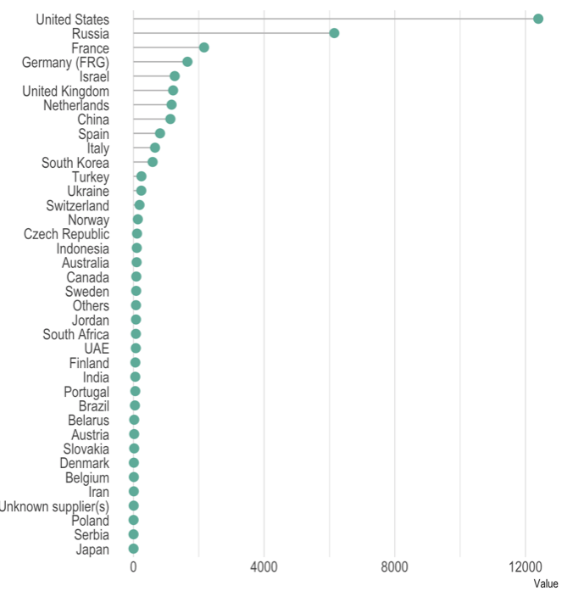
Order your data

Slide 36
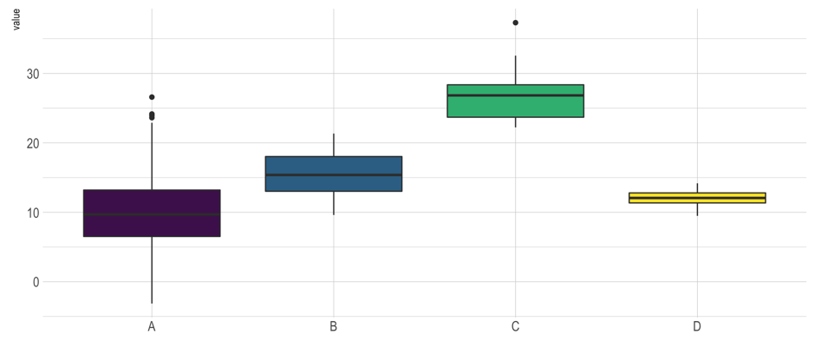
Anything wrong here?

Slide 37
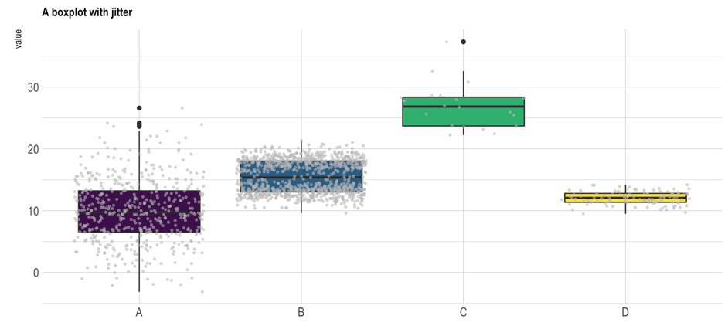
Boxplot = hide information
Almost no data !
Bimodal distribution

Slide 38
Boxplot = hide information
If small sample size, add data points with jitter
Almost no data !
Bimodal distribution

Slide 39
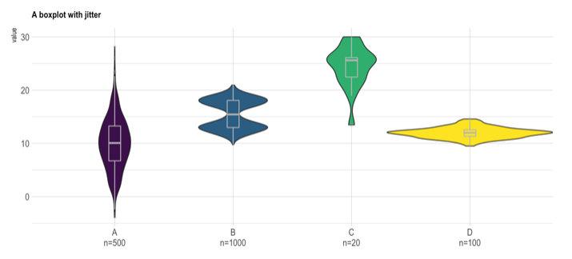
If big sample size, use violin plot
Show distribution
Show sample size

Slide 40
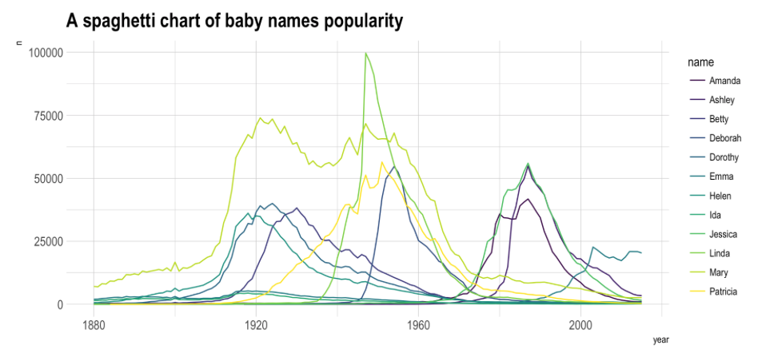
Look at this chart

Slide 41
What do you remember?

Slide 42
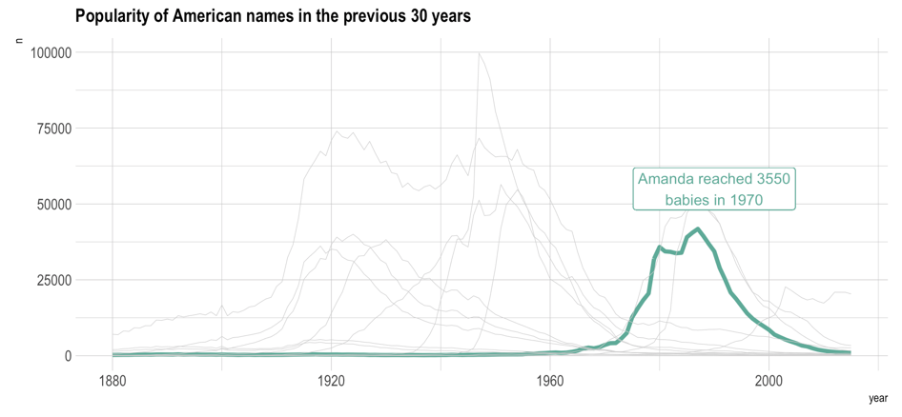
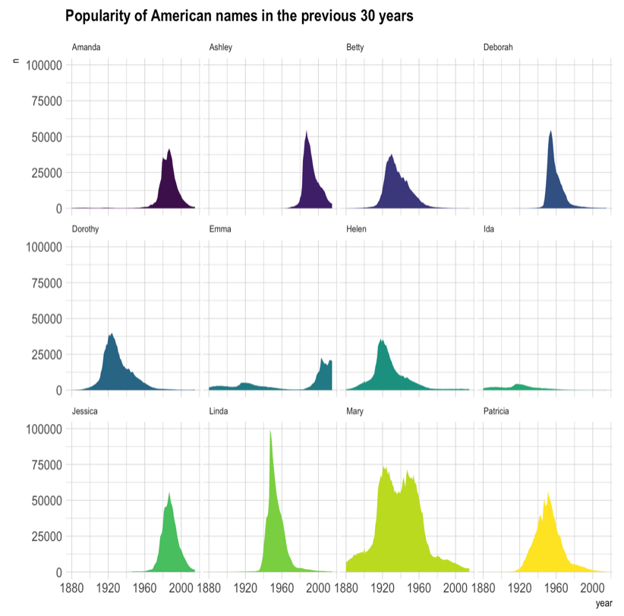
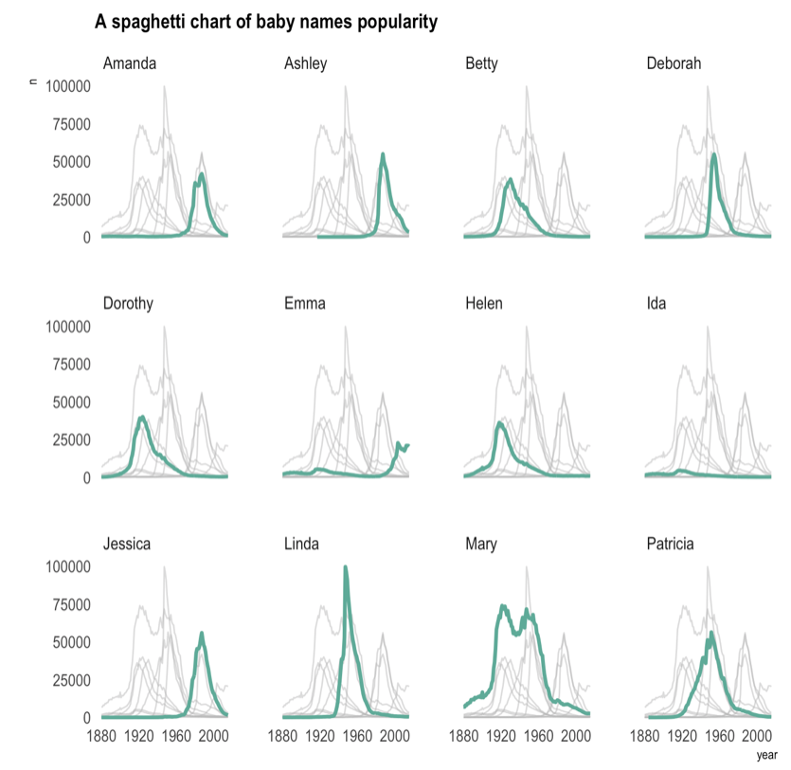
The Spaghetti chart
Read more

Slide 43
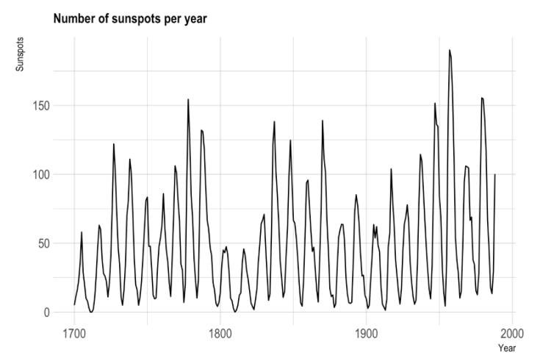

Slide 44
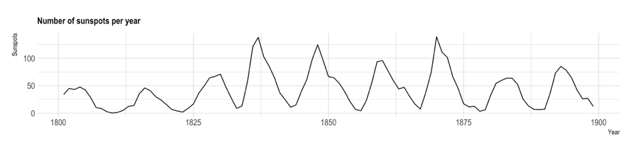
Mind the aspect ratio
Read more

Slide 45
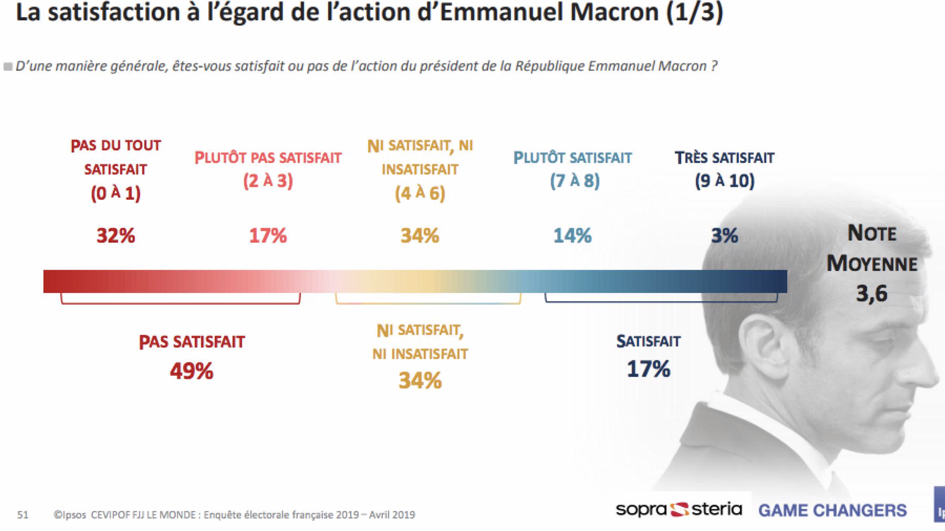

Slide 46

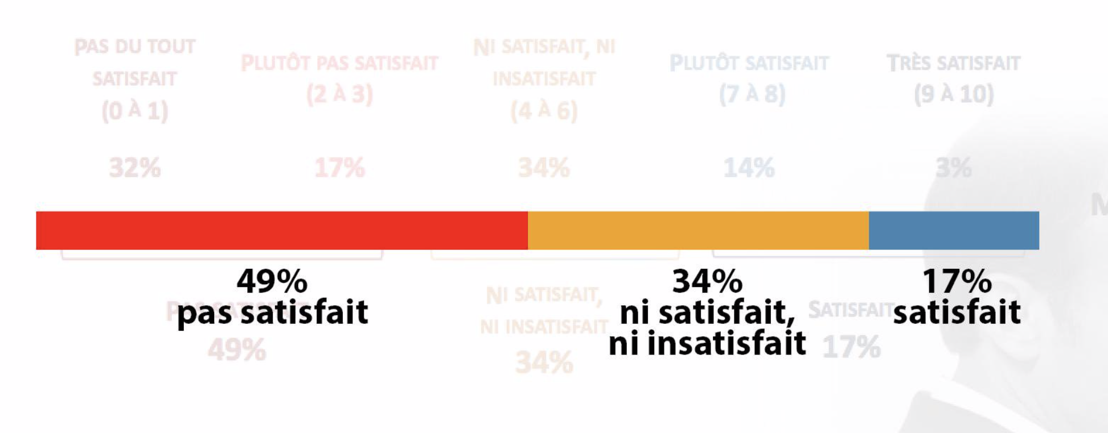

Slide 47
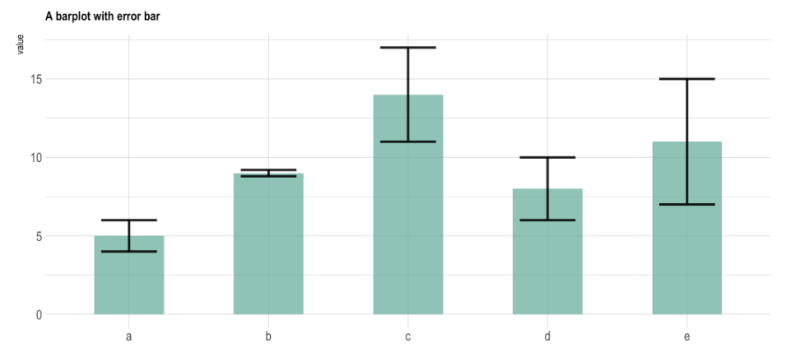

Slide 48
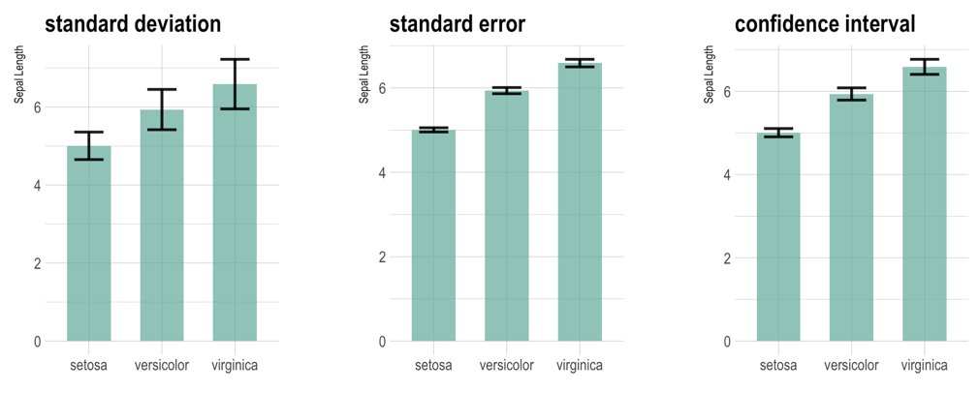
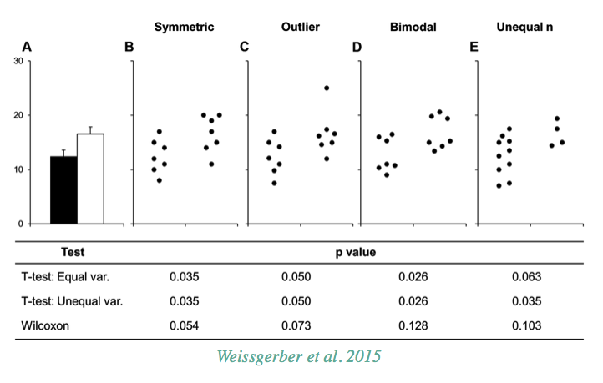
The issue with error bars
Read more

Slide 49
The issue with error bars
Read more

Slide 50
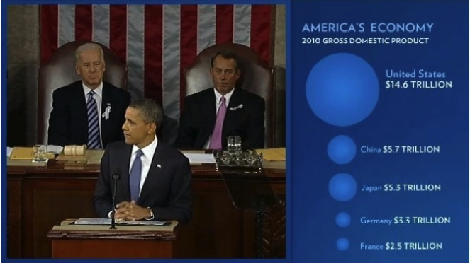

Slide 51
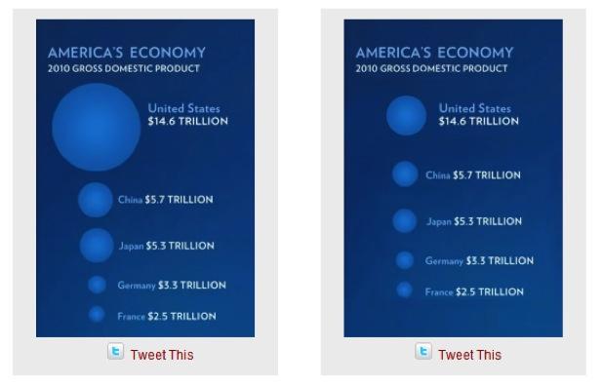
Size = radius
Size = area
Source: Fast Fedora blog

Slide 52
Size = radius
Size = area
Area = poor metaphor
Source: Fast Fedora blog

Slide 53
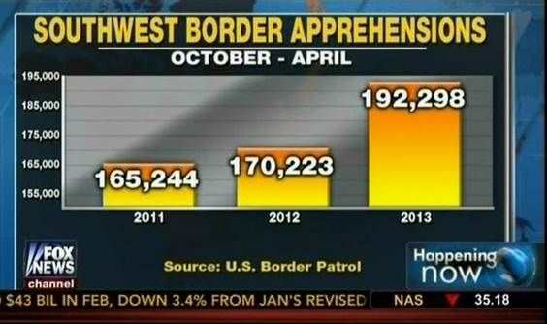
Source: Fox News, via Media Matters for America

Slide 54
Obama adminitration
=
2x more apprehensions?
Source: Fox News, via Media Matters for America

Slide 55
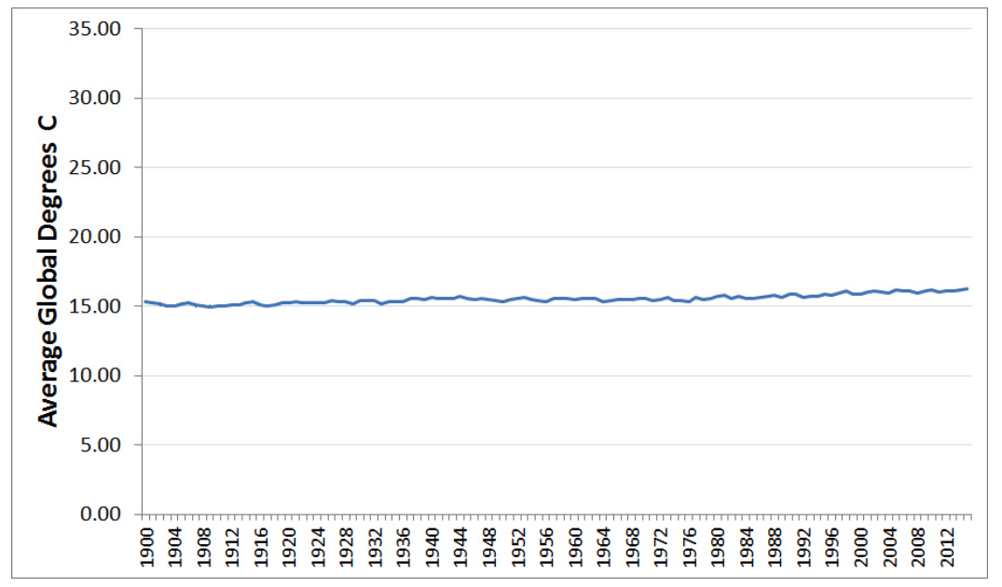

Slide 56
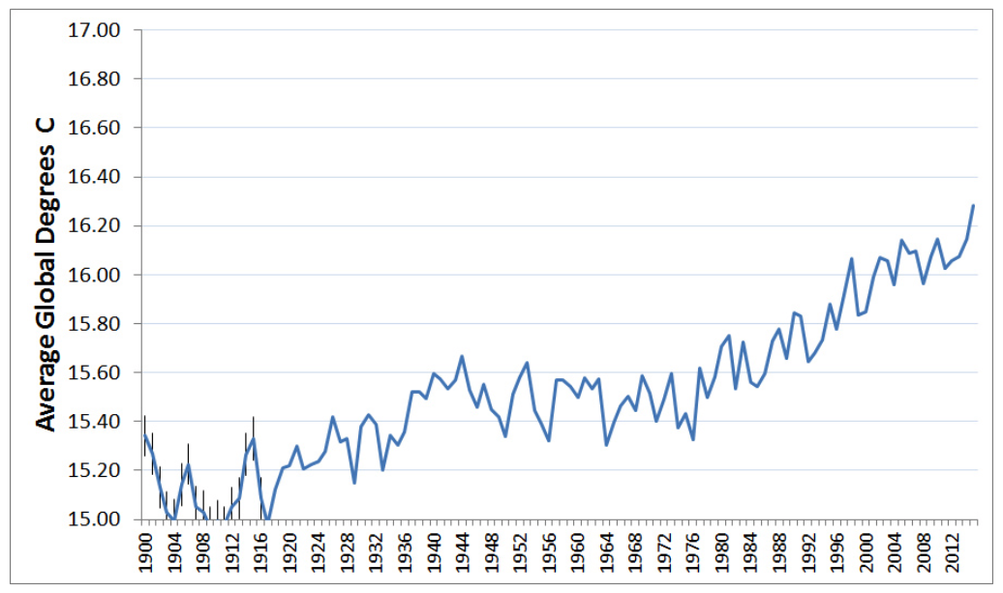
“In general, in a time-series, use a baseline that shows the data not the zero point” - Edward Tufte

Slide 57
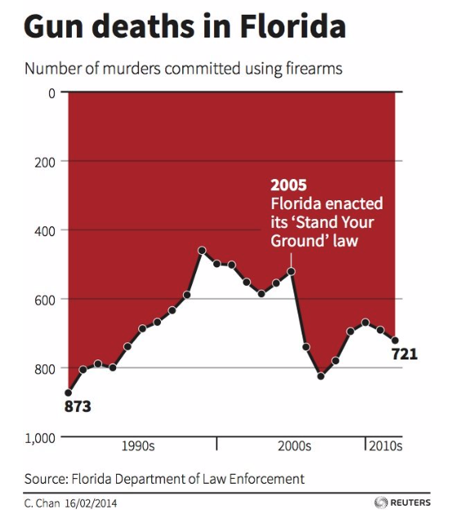
Source: KD Nuggets

Slide 58
Do not be
counter intuitive
Reverse Y Axis
Source: KD Nuggets

Slide 59
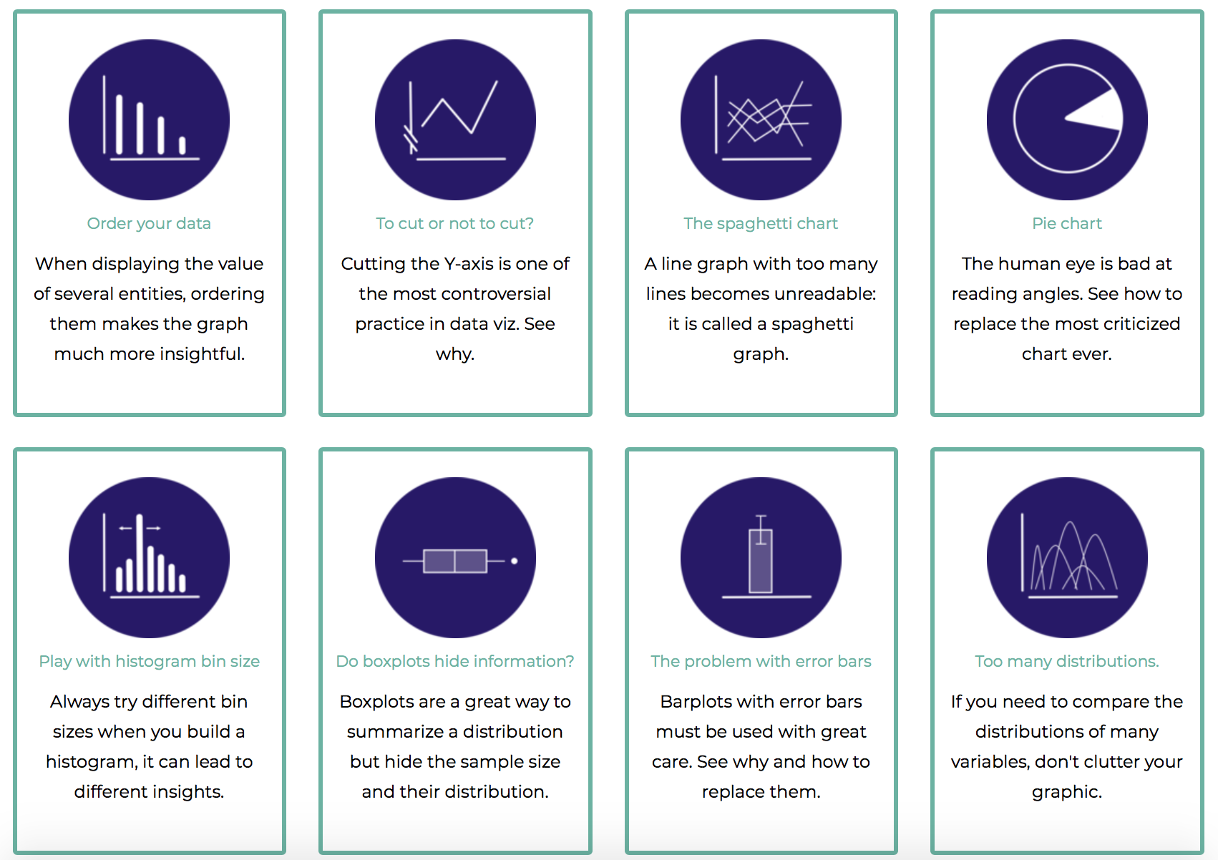
Data-to-viz.com/caveats
Data to Viz
A collection of dataviz caveats

Slide 60
HOW TO DO IT
The R and Python graph galleries

Slide 61
See the chart maker directory by visualisingdata.com
Data Wrapper
R
Flourish
Python
Tableau
SAS
Jump
MatLab
Excel
QlikView
Julia
D3
Easy
Limited
Hard
Flexible
* Far from being exhaustive

Slide 62

See the chart maker directory by visualisingdata.com
Data Wrapper
R
Flourish
Python
Tableau
SAS
Jump
MatLab
Excel
QlikView
Julia
D3
Easy
Limited
Hard
Flexible
* Far from being exhaustive

Slide 63

R-graph-gallery.com
Python-graph-gallery.com
D3-graph-gallery.com
Notes:
Demo d3-graph gallery.com

Slide 64





Data-to-viz.com
@R_Graph_Gallery
github.com/holtzy/Talk
Yan.holtz.data@gmail.com
www.yan-holtz.com

Slide 65



